Slide 1
UCSB Packaging Workshop
Phil Skochinski
26 January 2024

Slide 2
What would you like to learn?
Your answers go here.

Slide 3
Outline
Objective
  Hints on packaging.
  I would like you to think.
    Figure out what questions to ask.
    Give you the tools needed to find your specific answers.
  Resources: what common industry tests need to be met.
Not covering
  Waveguide theory, optical coupling theory.
  Not much math here.
Stuff I cannot talk about
  Vendors, specific processes, specific materials, specific tools.
Detailed Topics.
Green Packaging.

Slide 4
Background
Physics
Photonics
  Fiber gyroscopes. Optical design & test.
  Various sensors: Acoustic, Coherence-multiplexed. Optical design & test.
  Add/drop thin-film DWDM filters. Design test station, worked on Telcordia standard.
  Lithium Niobate modulators. Optical design, packaging, RF design and test.
  QCL packaging, RF design.
  PLC packaging.

Slide 5
How I got started in Packaging
I often liked the cool-looking packages for various parts….
No mechanical engineers, we needed updated tooling…
  Received some training on SolidWorks.
  Started making various tools used in different processes.
    Wafer fabrication process tooling.
    Packaging/Assembly tooling.
  We needed new packages
    Modify existing designs.
  Updates/designed ceramic chips with electrical traces (thin film network)
Software tools
  SolidWorks
  COMSOL

Slide 6
What other topics might be pertinent in packaging?
Your answers

Slide 7
Related Concepts
Packaging photonics will involve related subjects
  Tooling – You will likely need to design & fab custom tools.
  Machine shop techniques/Mechanical Engineering
  Lenses. Often required. First order (thin lens equations) goes 90% of the way.
  Thermodynamics. Usually just need simple heat flow equations.
  Electronics
    Building circuit traces, usually low speed low-medium power levels.
    High power
    RF circuit design
  Materials Science
    Usually surfaces. How do different surfaces interact/react.

Slide 8
Related Concepts - continued
Industrial Solutions to Various Issues
  Getters (materials that grab other things)
    moisture
    Particle
    Specific gases
  Absorbers
    RF
    Acoustic
    Mechanical
  Standardized Testing
    Why—you will need to be able to prove the part works well.

Slide 9

Some Questions…We have a die; now what?
Guidelines.
  How do you decide what to do?
How to start from scratch.
  You are employee #3 at a start-up.
  How to quick make/mod a package
Failure mechanisms.
  How to avoid problems.
Internal development processes.
  What simple tests/processes can we use?
“Standardized” Qualification processes.
  What standard tests are required for our part?
Production Testing.
  What tests do we perform on each part?
Examples.

Slide 10
Guidelines
Keep packaging simple
  Keeps assembly processes easier.
  Rework is simplified.
  Work Instructions (i.e. how to tell others what to do) are easier.
People will always make mistakes
  Plan on ways to prevent installing/orienting parts the wrong way.
  People will forget the work instructions.
Symmetry/Uniqueness
  Use symmetry.
  Uniqueness: make sure a part cannot be installed incorrectly.
Keep epoxy thickness to a minimum.
  UV curable. Parts can have shadows.
Positioning
  Use tooling, sub-mounts, features to help position parts.

Slide 11
General Thoughts
List what is needed.

Slide 12
General Thoughts – Parallel Considerations
Define your Requirements
  This will help you decide what to do.
  This can include processes and process sequences.
How to Assemble the components.
  Automatic
  Manual
Device Performance Requirements
  Housing.
    Size
    Thermal
    Electrical
    Optical
  Tooling
    What custom/COTS tools are needed
  Processes
    What processes will we need to develop

Slide 13
Starting from Scratch
Prototype package shape
  ‘L’-bracket
  Simple box
What size package
  Competition
Package material
  Gold-plated metal (typically Aluminum, steel)
    *very* common
    Many suppliers
  3D printed/sintered may be good for prototype
Electrical
  Power requirements
  Electrical Feeds
Optical
Thermal
Visual
  Look at each part in detail.

Slide 14
Rough Starting Point for Packages
Size
  10’s of mm
  Height ~ 10mm
Material
  Steel
  Aluminum
Package walls
  Typically 0.5 – 1.0mm
  Base ~ couple mm
  Lid – 0.2mm
    Glued or
    Seal sealed
Mounting
  Make slots/holes for easy mounting

Slide 15
Internal Developments
Often have limited quantities of the device you are developing.
Explore physical properties
  Over temperature, humidity, pressure
  Applies to epoxies, solders,
  sensitivities to optical misalignment.
  Electrical resistances.
  Impact of wirebonds on RF performance.
  Application of custom materials
Setup side experiments
  Use similar devices (fiber to fiber instead of fiber to laser)
    Different epoxy thicknesses.
    Different epoxies.
    Try different lens to fiber arrangements.
    Make a strip of conductive epoxy to determine resistance
    Use XYZ stages to determine optical alignment sensitivity

Slide 16
Internal Development Thoughts
How do we prove a certain packaging process works?
Thermal Cycling
  Simple way to exercise stresses
  Oven & data acquisition
  $
HALT/HASS (Highly Accelerated Life Testing/Stress Screening)
  Stress to the point of failure
  6 axis shaking/rotation (+temperature)
  $$$

Slide 17
Tooling aside
Many processes will require custom tooling.
Put a part number on tooling.
Materials
  Metal(s)
    Stainless steel for better precision
    Aluminum ok
    Tungsten if you really need a hard part
  Teflon/Delrin as inert “plastic”
  Ceramics
    Alumina
    Aluminum nitride
  3D printed
  3D sintered metals (not quite as mature)

Slide 18
Failures – How to avoid
Materials
  Match CTEs
    Reduces strain
    The opposite of strained QW lasers.
  Metal-metal interactions
    Galvanic
    Tin-silver
  Epoxies
    Still hard to determine best
    How much epoxy
    Cure process(es)
  Interactions with the environment
Quantify your requirements
  Alignment, temperature, electrical…

Slide 19
Materials
How do determine what materials to use?
Usually, an iterative process
  What physical properties are important
    Thermal
    Mechanical
    Electrical
    Optical
Look up properties
  MatWeb. https://matweb.com/
  CRC Handbook of Chemistry & Physics book (ha).
  Multi-Physics software will often have values.

Slide 20
Materials Comparison-Thermal
Material | CTE ppm/C | Conductivity W/(m-K)
Glass | 6 | 200-300
Metals | 10-20 | 200-300
Adhesives | 50-300 | Very low
Adhesives w/ metal | 50-300 | 5-10
Solder | Sim to metal | Sim to metal

Slide 21
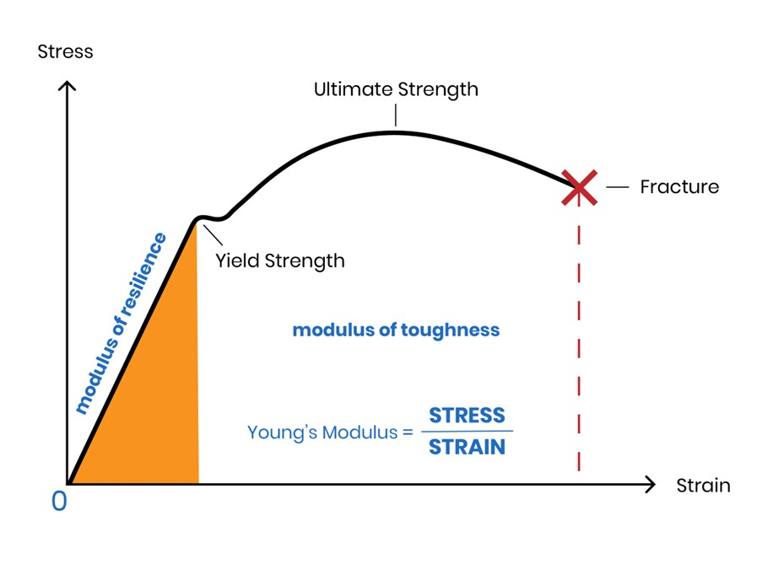
Materials Comparison-Mechanical
Material | Shore D Hardness | Thermal Dependence |  | Notes | Poisson’s Ratio | Youngs Modulus
Glass | ~90 | small
Steel | ~90 | small
Adhesives | 30-70 | Can be large |  | Rigid at cold temp
Golf ball | 50
Wooden ruler | 70
Other hardness scales
Shore A, Rockwell

Slide 22
Adhesives
What is important in epoxies?

Slide 23
“Epoxy” Properties - Very Inconsistent Manuf. Data
Viscosity (before cure)
Working life (pot life)
Tensile strength
Peel Strength
CTE typically 100+ppm/C. 10-20x that of metals, glasses.
Glass Transition Temperature
  The temperature at which material properties change
    Higher CTE
    Different Thermal/electrical conductivity
Thermal conductivity
  Metal loaded are decent.
Electrical conductivity
  Metal loaded epoxies (typically silver) have low resistances, otherwise very low.
  Often used for electrical connections.
Hardness – not as hard as glass/metal.

Slide 24
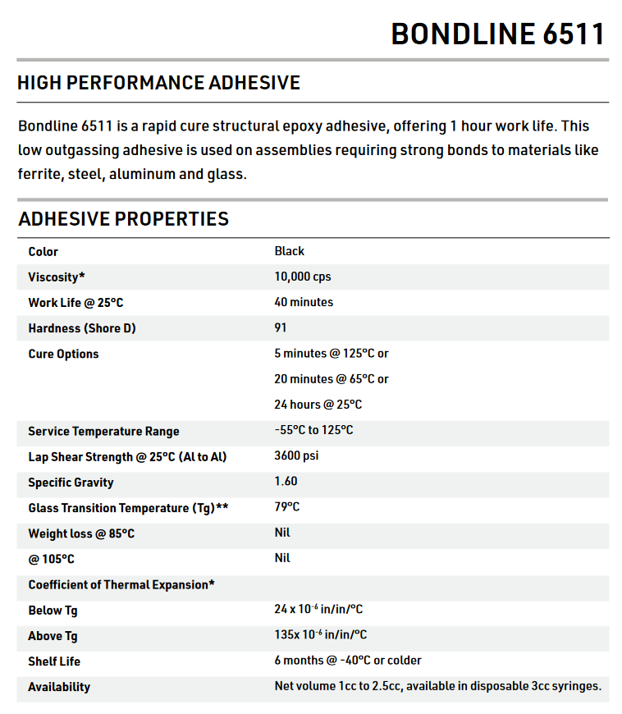
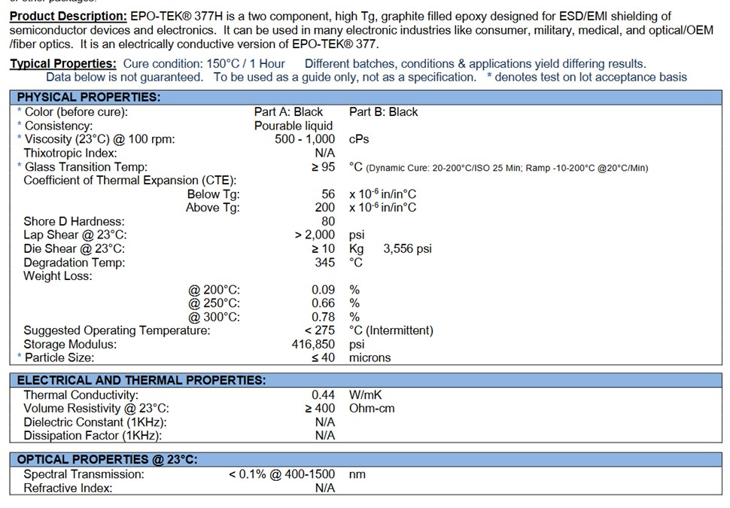
Datasheets

Slide 25
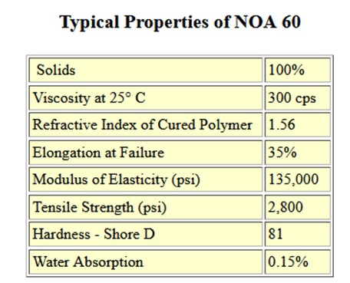
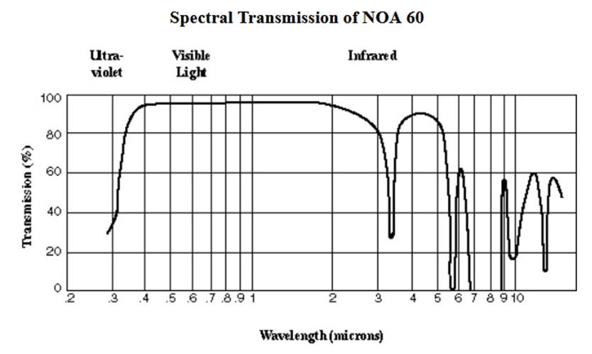
Another Datasheet
What Information is missing?

Slide 26
Adhesives Comparisons
Adhesive | Viscosity | Tglass C | CTE ppm/C <Tg >Tg |  | Tensile Strength | Peel Strength | Shore D Hardness | Volume Shrinkage | Outgassing
NOA 61 | 300 |  |  |  | ? | ? | ? | ? | ?
NOA 63 | 2500 |  |  |  | ? | ? | ? | ? | ?
353 | 4000 | 90 | 54 | 206
H70S |  | 50 |  |  |  |  | 83
Missing information. You will have to determine if the material works.
Notes:
Outgassing related to material loss, weight change.

Slide 27
Epoxy Guidelines/Notes continued
Cure method
  UV + Thermal is best
  UV (wavelength range can be hard to determine)
  Thermal
Cure Temperature
  Actual cure temperature might determine the “neutral point” temperature.
Amount
  Less is typically better. Why??
  Typical volumes very small ~ 1 cubic mm (=micro liter)
Application methods
  Often manual
    Use surface tension.
    A drop on a small wire.
  Micro-pipette (often used in bio tech)
  Automated dispensing available, but more $$, time up-front.

Slide 28
UV Epoxies
Heavily Used-Many suppliers.
Check Manufacturer for recommended material/surface compatibility
  Find the expert within the company
Great for quick cures.
Heat
  UV sources can generate a lot of heat
  Metal tool exposed to UV can heat up
  →Heat means parts will move.
Most durable is UV + Heat
  Check part again after heat
  Can skip the heat for prototype testing
  Temperatures for heat cure typically in the 90C range

Slide 29
Temperature Sensors
Thermistor
  Very common
  Nonlinear, but well characterized
  Put in a curve
Thermocouple
RTD
  Linear
  Not used as often

Slide 30
Force – CTE mismatch
CTE mismatch creates forces
  (think of strained QW lasers)
F=E*α*ΔT*A [Pascals in SI or PSI in Imperial]
  E-Youngs modulus
  α coefficient of thermal expansion
  ΔT temperature change
  A cross sectional area

Slide 31
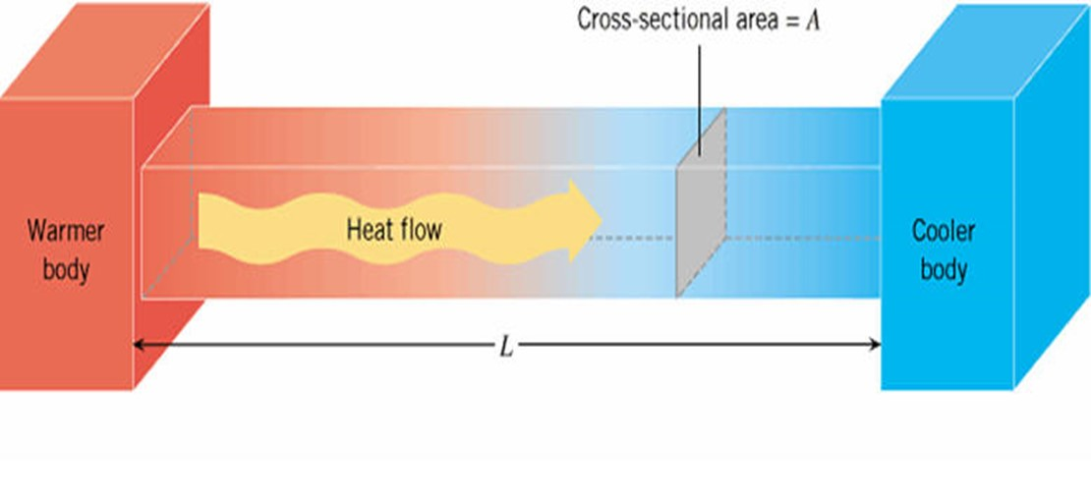
Thermal Calculations
Simple Heat Flow - Conduction
Thermal conductivity
  σ_{T} [Watts/(m-K)]
Temperature change
  (T₁-T₂)=Q*R_{T}
  R_{T}=L/(A σ_{T}) Thermal resistance [K/W]
    h=1/R_{T} heat transfer coefficient
Multiple Layers of Materials
  Add R_{T}
What is Q for a laser diode?
Q heat flow [Watts]
Laser materials housing
Notes:
Omitting the time dependence.
Laser, materials = adhesives, etc., housing=package wall, heat sink.

Slide 32
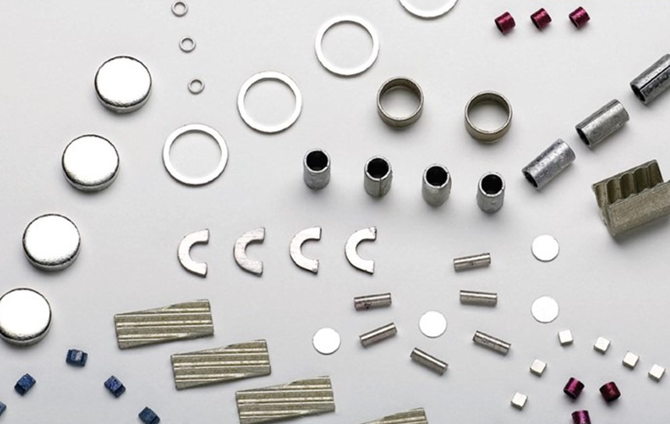


Solder
RoHS vs non-RoHS
  Lead content by weight of a final package.
Shape
  Usual wire.
  With and without flux.
Preform
  Premade design with a specific shape.
Heating methods
  Irons/guns
  Convective/radiant using shaped wire
  Inductive Heating (Eddy current)
Notes:
Heavily used.
RoHS higher melting temperature.

Slide 33
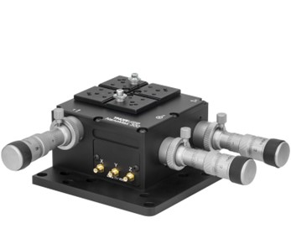
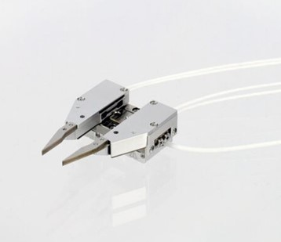
Positioning Parts
How do you precisely (μm level) components?
  Use mechanical grippers atop stages
  Mechanical – spring loaded (0.1mm)
  piezo (sub micron)
  +

Slide 34
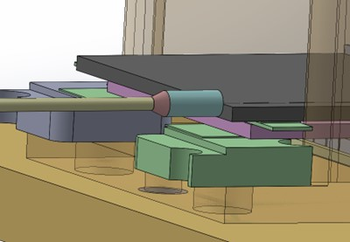
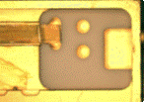
Positioning Parts
Height adjustments. Suppose you have components that need differing heights
  Use “standoffs” to set a height, Green are temporary standoffs
  Ceramics (many different materials, alumina (Al₂O₃), aluminum nitride Al₂N₃, etc)
    Many vendors with standard or custom thickness
    Wafer based
    Rough surface or polished.
    ~can get 10um tolerance
  Steel
    Another option.
    Height tolerance not a good as ceramic, typ 50um
  Tape
    When some flexibility is needed
    Tolerances ~20-30um.
  Can use to x,y position too.
Ceramic used to force a position for an e/o chip

Slide 35
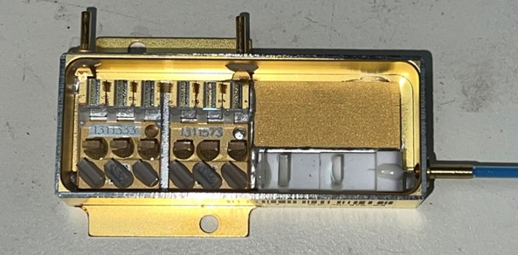
Positioning Parts
Sub-mount
  Often use sub-mounts inside of packaging when using multiple parts. Why??

Slide 36
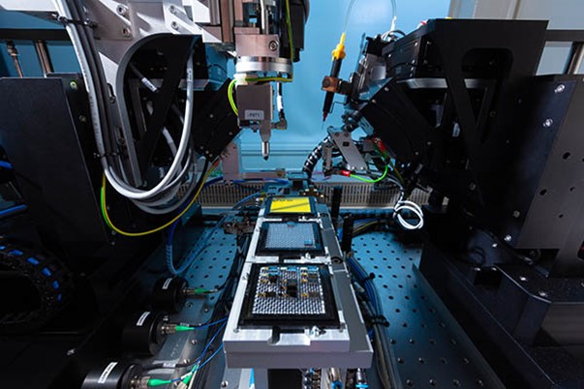
Pigtail Station Photos
Positioners
Light pipes for either illumination, UV
Epoxy dispensers

Slide 37
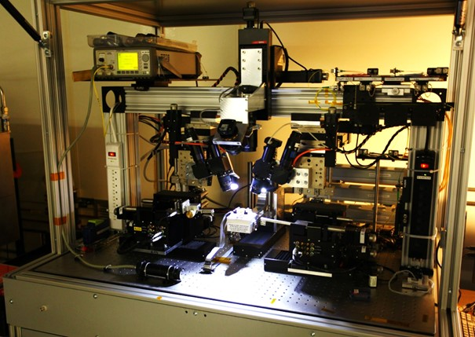
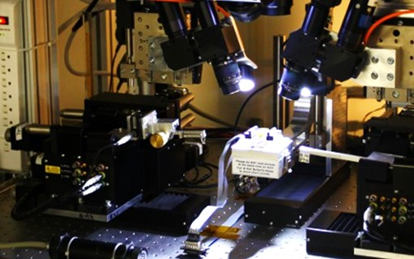
Fiber Attach
Illumination/cameras
Positioning stages

Slide 38
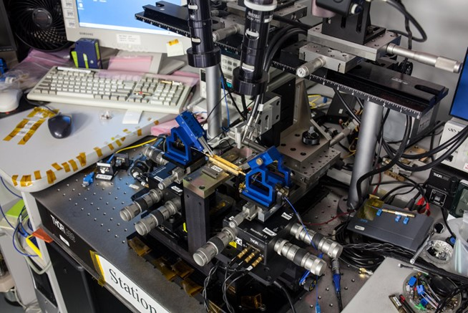
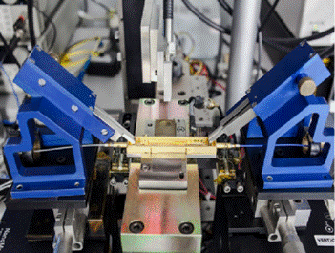
Fiber Attach
Fiber attach tooling
  Grippers, Housing clamp
  Mechanical stages
  Rotational alignment
  Light pipe
  Custom tooling

Slide 39
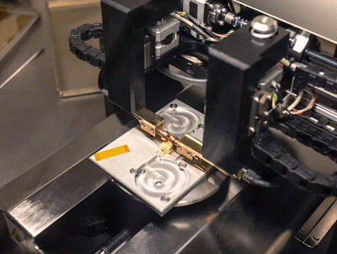
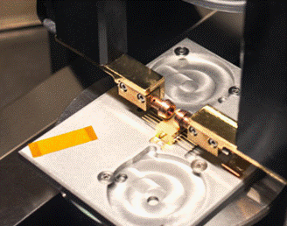
Sealing
Non hermetic – best for passive parts. Use adhesives.
Airtight seal = hermetic (He gas leak rates typ < 10^-7)
  Melt a thin lid onto a housing by running Amps through the part.

Slide 40
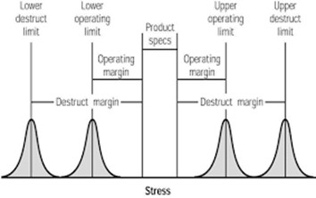
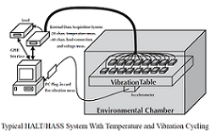
Reliability
Determine/test how long a device will work
Reliability Curve and stress screening (bathtub curve)
Production Testing used to remove infant mortality & confirm specs
Common standards used to determine operating limits
HLALT/HASS used to determine destruction limits
  3 axis shaker table + temperature

Slide 41
Reliability
How do you measure reliability?
  Failure rate (FITs)
  Weibull distribution (bathtub curve)
Other topics on reliability
  DOE
    Various designs, no repeats
    One design, many repeats
  SPC
    More manufacturing related.

Slide 42
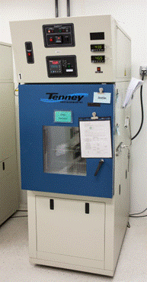
Production Testing
How do we typically test production parts.
  Thermal cycling.
  Monitor optical power.
  Monitor current/voltage.
  Automated Stations

Slide 43
Standardized (public) Qualification-Overview
Standards exist to provide a common set of tests
Typical tests
  Thermal cycling
  Aging, often at elevated temperatures.
  Damp heat.
Sources
  Telcordia (commercial photonics)
    Originally related to Bell labs (called Bellcore standards)
  MIL-SPEC (often referenced in commercial tests)
  Workmanship (JEDEC)

Slide 44
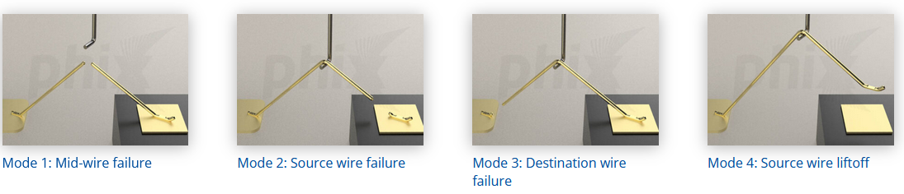
Standardized (public) Qualification-2
Scope
  Electrical
    Wirebonds.
      Pull to fail test
    Metal-metal interactions
  Optical
    Loss
    Device specific tests
      LI, PER, on/off properties.
  Mechanical
    Temp cycling
      -10 to +85C typical for telecom.
      -57 to 85C, or 125C for Military.
    Damp heat
      80%RH/80C for 1000s of hours.
    Vibration/acceleration
      Usually given as G’s of acceleration vs. frequency (think of a psd).
  Lifetime
    Use high temperature to estimate lifetime

Slide 45
Standards
Telcordia Generic Requirements for telecom equipment
  Originally started as “Bellcore” in the 19s to reduce equipment failures.
    Telcordia acquired by Ericsson.
  Typically test 11 devices without failure.
  GR-63-CORE Network Equipment in Buildings: Physical Protection
  GR-468-CORE. Generic Reliability Assurance Requirements for Optoelectronics Devices Used in Telecommunications Equipment.
  GR-1209-CORE Generic Requirements Passive Components
  GR-1221-CORE-Generic Reliability Requirements for Passive Components
  GR-3013-CORE Generic Reliability Requirements Optoelectronic Device – Short lifetime
  Many others,.
Mil-Spec
  MIL STD 202 Test Method Standards
  Mil STD 217
  MIL-STD-883 Test Standards Microelectronics

Slide 46
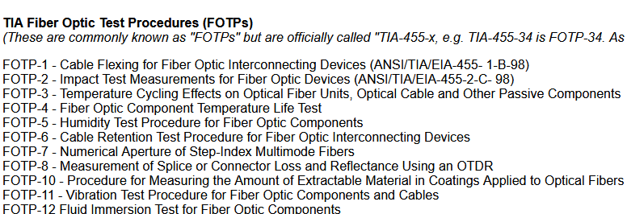
Standards Continued
Standardized Fiber Optic Test Procedures
  Commonly known as FOTP
  Officially knows as TIA/EIA. http://www.tiaonline.org/
  Optical Loss, PER,
  See also https://www.thefoa.org/tech/standards.htm
  Good to be aware of.

Slide 47
Machine Shops
On-line (just send a CAD file)
  Xometry
  Protolabs
  Machining tolerances can vary, so investigate.
Local
  UCSB Machine Shop https://machineshop.engineering.ucsb.edu/
Tolerances
  Metals ~50um
  3D printed 100’s um
  Ceramics 10’s um
Make your drawings in SI
  Typically, mm.
Most US machine shops use Imperial
  Inches
  Mils (or thousandths or thou)
Be friendly with a machinist; you will learn things.

Slide 48
Example from my past
Pigtailing lithium niobate Chip (Polished Si V-groove)
  Requirements stable optical power transmission
    over -55 to +85C.
    Vibration
  Methods
    Weld
    Epoxy
    Lens coupled (concern about long term impact of epoxy).
Process chosen was epoxy
  One Vendor, multiple “nearly” identical epoxies.
  Method
    Thermal cycling.
    Large number of samples.
    Compare loss before and after.
    Vibration Testing also performed.
  One epoxy performed better. Why? Unknown.
  Experiments are needed; do not just rely upon vendor data.

Slide 49
References
Packaging
  Ulrich H.P. Fischer-Hirchert, Photonic Packaging Sourcebook,, 2015
    1/3 of the book on photonics equations/concepts.
    2/3 on differing techniques.
  Handbook of Electronics Packaging Design and Engineering
    Dated, electronics packaging focus (not photonics).
    Many good illustrations-get ideas of attachments.
Hermeticity
  Hermeticity of Electronics Packages, 1st or 2nd edition (1999, 2012)
    The “Bible” of hermetic packaging.
    Very detailed, review kinetic theory.
Electronics
  Horowitz & Hill, The Art of Electronics, 3rd edition
    Great general reference for electronics.
Materials
  Tilley, Understanding Solids.
  Heavens, Optical Properties of the Thin Sold Films.

Slide 50
More References
Optics
  Optics, Hecht and Zajac (more practical than Born and Wolf).
  Principles of Optics, Born and Wolf (for completeness).
  Derickson, Fiber Optic Test and Measurement.
Thermal
  Sargent & Krum, Thermal Management Handbook for Electronic Assemblies.
IEEE Electronics Packaging Society (https://eps.ieee.org/)

Slide 51
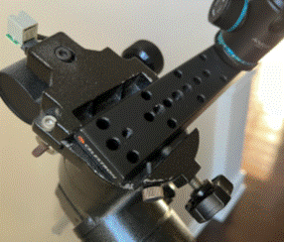
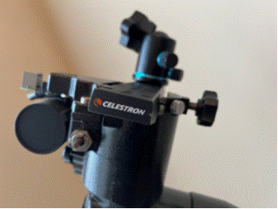
Where else can you get packaging ideas?
Inspect other devices. What can you learn?
  My German equatorial telescope mount. Why two screws? What shape is the “bar” and why?
YouTube U
  General concepts.
  Don’t expect great detailed information.

Slide 52
Green Packing
This may not apply to micro-electronics often.
Try your best to find solutions that use renewable resources.
Best examples: shipping containers.

Slide 53
Summary
Many different skills needed.
Define initial requirements.
  Critical!
Perform calculations/modeling where possible
  Excel, python, Matlab.
  Multi-Physics-based modeling (ANSYS, COMSOL).
  Specialized (single physics) modeling (HFSS for RF, SolidWorks for thermal, vibration dynamic modeling).
CAD tools
  SolidWorks, AutoDesk (LT for 2-D drawings)
    Libre CAD for 2-D
  Pspice or free equivalent (Ltspice)
Perform easy test
  Temperature cycling.
  Side experiments.

Slide 54
Thank You !!
Any questions?

