Slide 1
Life at a Photonics Startup – A very personal account!
Daniel Renner, Ph.D.
- Atacama Optics & Electronics, Santa Barbara, CA
- IEEE Photonics Society Industry Engagement Committee
IPS Distinguished Lecture Series
Presented at Photonics Society at UCSB
Santa Barbara, CA
February 8th, 2024
Contact information:
Daniel Renner
daniel@atacamalight.com
+1-805-729-0514

Slide 2
What are we exploring today?
My professional trajectory:
Key events from my own work experience
Lessons learned from these key events
Life at a Photonic Startup:
How do these lessons learned apply to:
Business Plan / Proposal preparation
Budgeting
Funding
Team Leadership
Program Management
Sales and Marketing
Commercial opportunity development
Creation of a successful photonic startup ecosystem
Etc.

Slide 3
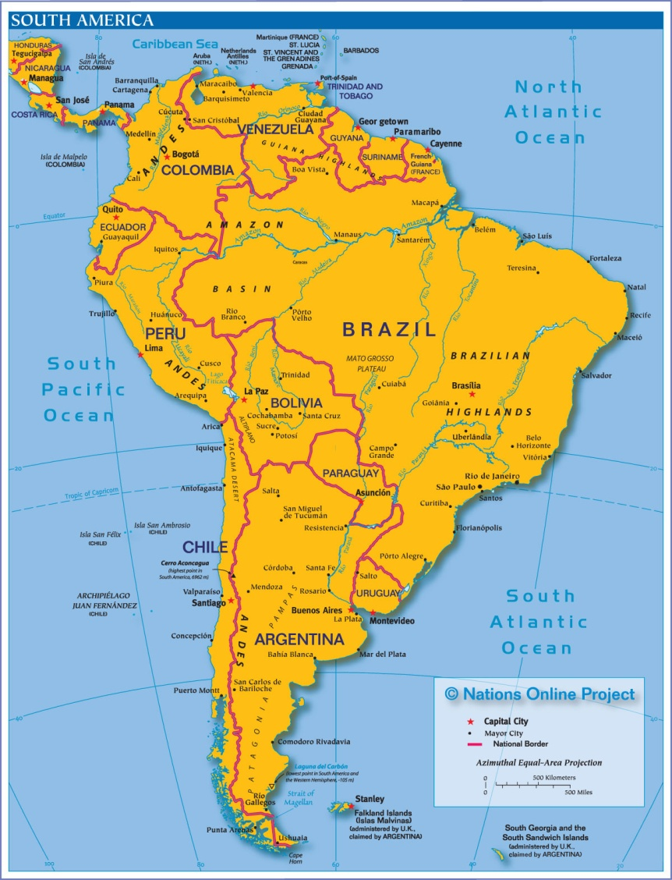
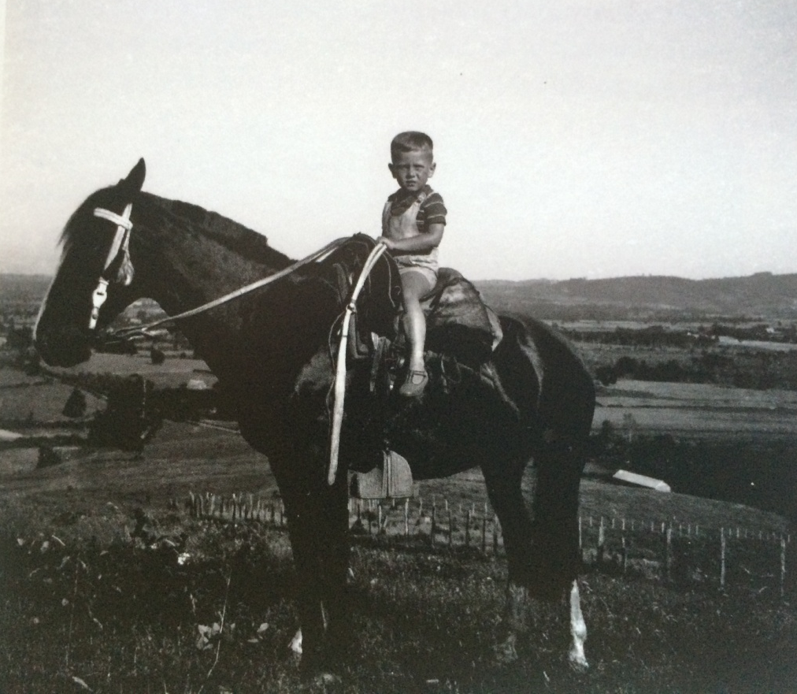
Patagonia
I grew up in a farm in the wilderness of Chilean Patagonia

Slide 4
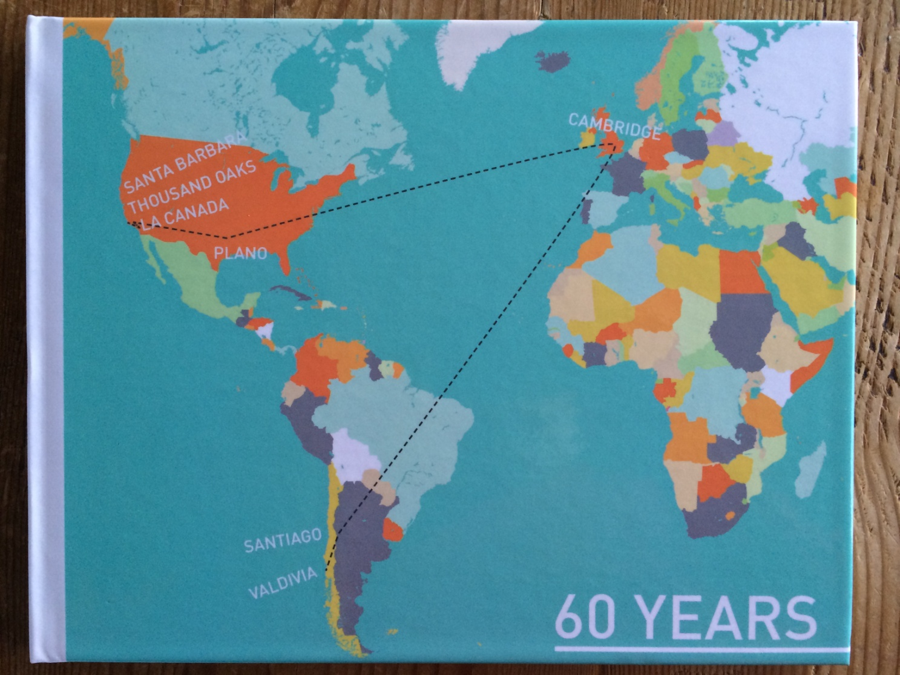
Life trajectory
In my early twenties I decided to leave the Patagonian open spaces for the High-Tech open fields…

Slide 5
Professional trajectory
Universidad de Chile
Santiago, Chile
University of Cambridge
England
ITT Standard Telecommunication Labs (STL)
Harlow, Essex, England
Rockwell International
Richardson, Texas
Ortel Corporation
Alhambra, California
Agility Communications
Santa Barbara, California
Aerius Photonics
Ventura, California
Freedom Photonics
- Santa Barbara, California
Atacama Optics & Electronics
Santa Barbara, California

Slide 6
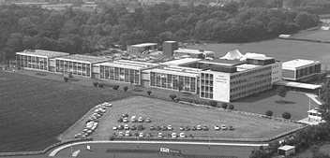
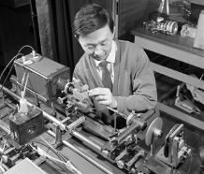
Standard Telecommunication Laboratories (STL)
Standard Telecommunication Labs
in Harlow, Essex, England
Charles Kao doing an early
experiment on optical fiber
communications at STL, in
1965

Slide 7
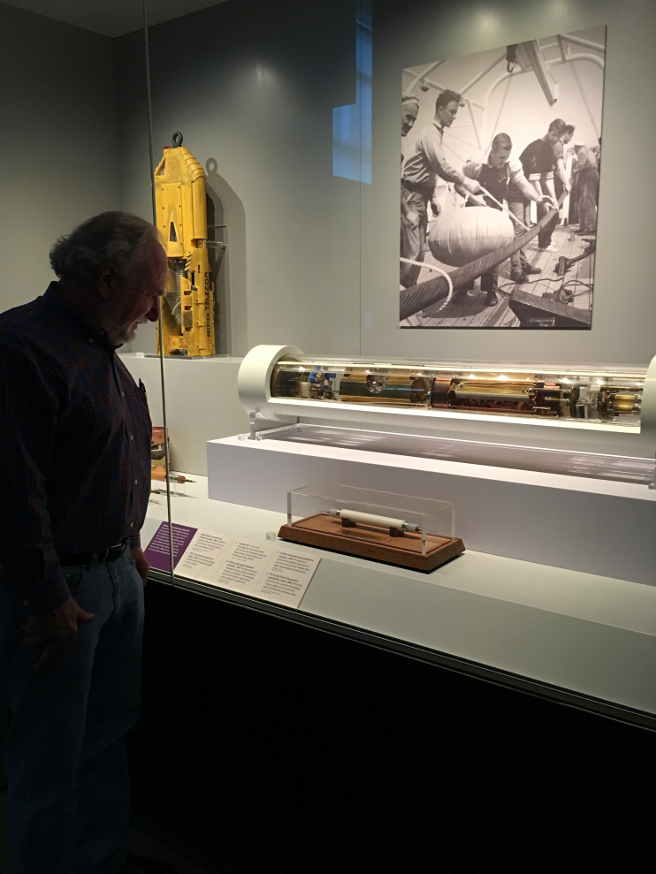
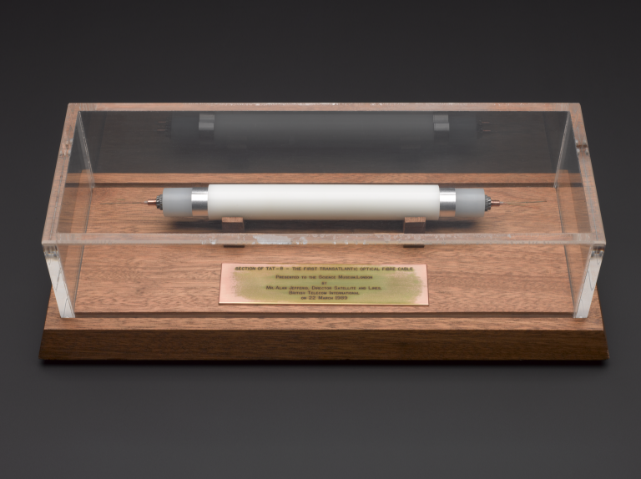
My life at STL (1980 – 1985)
Team developing 1310 nm diode lasers for the first underwater fiber optic cable system TAT-8 (Trans-Atlantic Telephone – 8)
Section of recovered TAT-8 at
the Science Museum in London
TAT-8 started operating in 1988

Slide 8
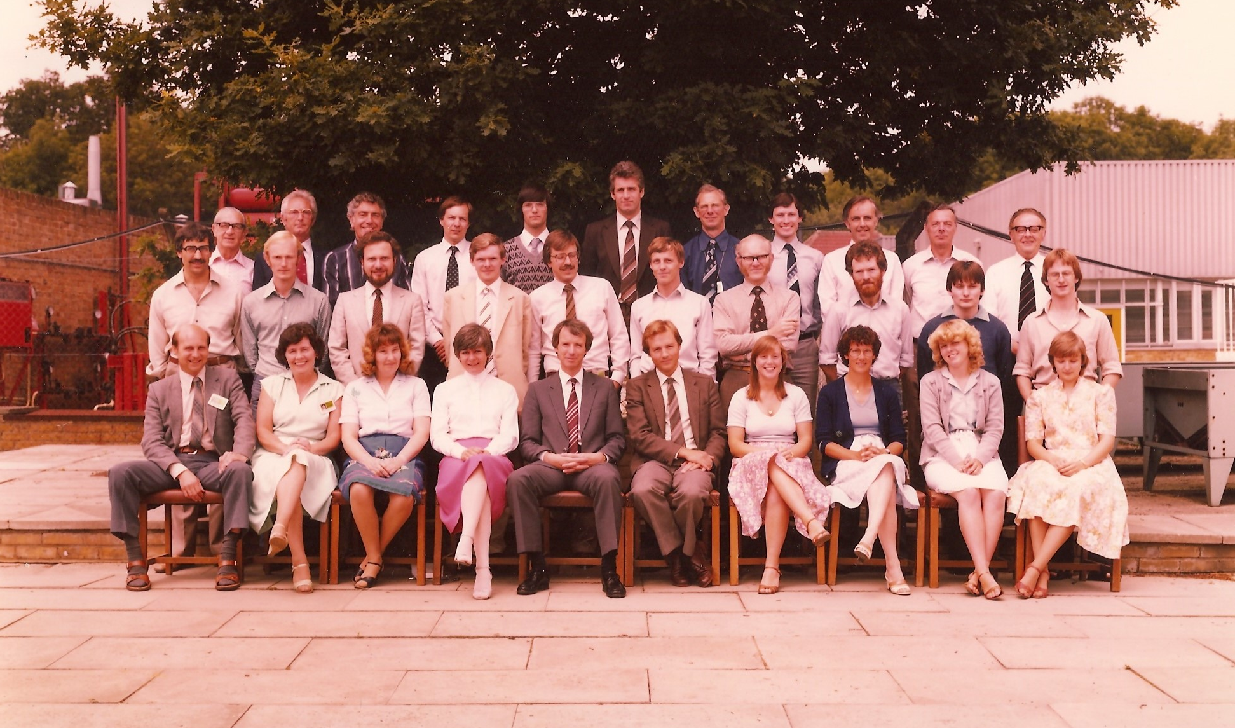
My life at STL (1980 – 1985)
Team developing 1310 nm diode lasers for the first underwater fiber optic cable system TAT-8 (Trans-Atlantic Telephone – 8)
STL Laser Group
Circa 1984

Slide 9
Lessons
Lesson # 1: Industrial Product Development is a team effort!
* You cannot develop a photonic product entirely by yourself.
* Photonic industrial R&D is more analogous to a football or basketball team than
to a golfer or tennis player
* Developing photonic products requires a broad range of technical specialties:
device design, materials science, electronic circuit design, mechanical design, etc.
* The team also requires expertise in areas other than photonic technology: finance,
marketing, sales, program management, human resources, IT, facilities, psychology, etc.

Slide 10
Lessons
Lesson # 1: Industrial Product Development is a team effort!
* You cannot develop a photonic product entirely by yourself.
* Photonic industrial R&D is more analogous to a football or basketball team than
to a golfer or tennis player
* Developing photonic products requires a broad range of technical specialties:
device design, materials science, electronic circuit design, mechanical design, etc.
* The team also requires expertise in areas other than photonic technology: finance,
marketing, sales, program management, human resources, facilities, psychology, etc.
Lesson # 2: You should work with people that you like!
It is the responsibility of the team leadership to foster a company culture where
there is no fear, in which people can creatively enjoy their working hours.
Develop your inter-personal skills. Communicate openly and truthfully.
Get to know your co-workers as the complete people that they are, you might
be with them for a long time, maybe most of your life!

Slide 11
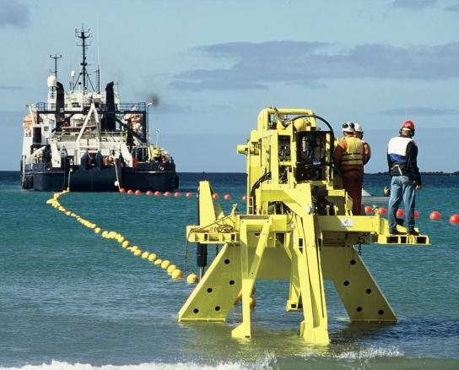
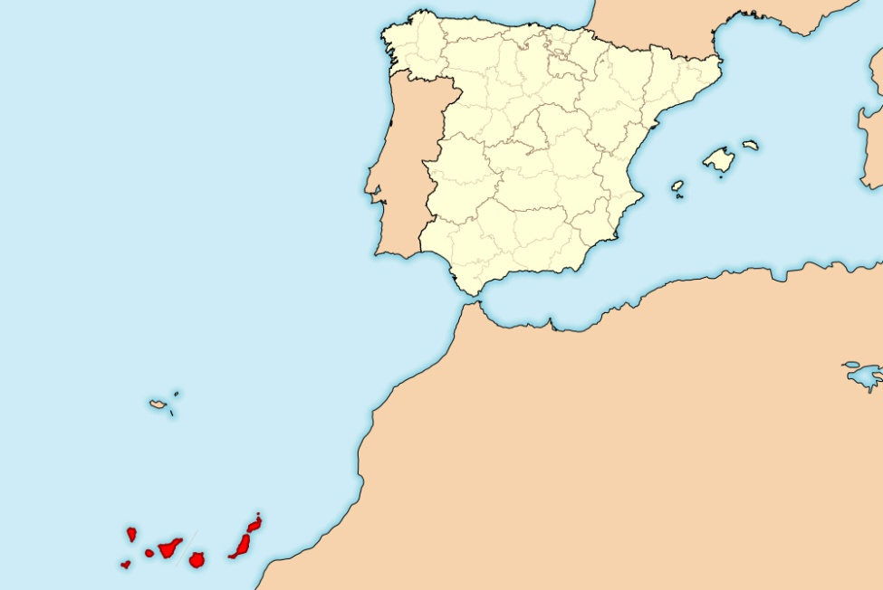
My life at STL (1980 – 1985)
Team developing 1310 nm diode lasers for the first underwater fiber optic cable system TAT-8 (Trans-Atlantic Telephone – 8)
Early test at the
Canary Islands
1985

Slide 12
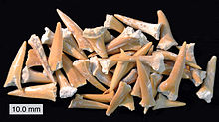
My life at STL (1980 – 1985)
Team developing 1310 nm diode lasers for the first underwater fiber optic cable system TAT-8 (Trans-Atlantic Telephone – 8)
Early test at the
Canary Islands
1985
Fiber-Optic Cable early test failed!
Shark teeth were found buried in the cable!

Slide 13
My life at STL (1980 – 1985)
Fast early testing was part of the program routine in developing the first diode lasers for underwater use:
Early reliability stress of diode lasers on submounts and packaged devices
Early testing of new processes:
Laser welding for packaging
Fiber-package hermetic sealing
Ohmic contacts to InGaAsP

Slide 14
Lessons
Lesson # 3: The results of early action many times are the difference between success and
failure
* Carefully thought fast action is key for successful development programs
* High risk, difficult problems, should be addressed as early as possible.
Ridiculously early!
* This applies to all types of problem: technical, financial, schedule, human, etc.

Slide 15
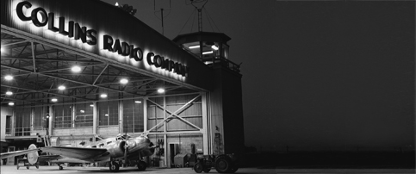
Rockwell International
Rockwell – Collins Transmission Systems Division
Richardson, TX
Rockwell – Collins was one of the dominant radio
Companies, and in the 80’s became the dominant
land-line fiber-optic comms system company

Slide 16
My life at Rockwell (1985 – 1991)
Director of Opto-Electronic Engineering – Developing and Manufacturing lasers and photodiodes for landline fiber-optic systems
Rockwell LTS 21130 – First system commercially deployed with capacity larger than 1 Gb/s
MCI INSTALLS FIRST FIBER CAPABLE OF
1.13 GBPS TRANSMISSIONS
MCI Communications Corp. has announced
installation of a 20 mile fiber link between New
York and West Orange, NJ, transmitting at 1.13
Gigabits per second and capable of carrying
16,128 simultaneous voice conversations, or the
data equivalent, over a single fiber pair, using
Rockwell International LTS-21130 lightwave
equipment. The company has claimed to be the
first long distance carrier to install initially 405 Mbps,
then 810 Mbps and now 1.13 Gbps fiber optic eqpt.
- Fiber Optics Weekly Update – May 22, 1987

Slide 17
My life at Rockwell (1985 – 1991)
Director of Opto-Electronic Engineering – Developing and Manufacturing lasers and photodiodes for landline fiber-optic systems
Rockwell LTS 21130 – First system commercially deployed with capacity larger than 1 Gb/s
MCI INSTALLS FIRST FIBER CAPABLE OF
1.13 GBPS TRANSMISSIONS
MCI Communications Corp. has announced
installation of a 20 mile fiber link between New
York and West Orange, NJ, transmitting at 1.13
Gigabits per second and capable of carrying
16,128 simultaneous voice conversations, or the
data equivalent, over a single fiber pair, using
Rockwell International LTS-21130 lightwave
equipment. The company has claimed to be the
first long distance carrier to install initially 405 Mbps,
then 810 Mbps and now 1.13 Gbps fiber optic eqpt.
- Fiber Optics Weekly Update – May 22, 1987
The LTS-21130 system
started development in
early 1986.
The first commercial
fiberoptic system operating above 1 Gbps took just one year to develop!
Initial deployment was
driven by QVC Shopping Network!!

Slide 18
Lessons
Lesson # 4: A talented and motivated team on a mission can beat the dominant top company!
The impossible is possible!
Surround yourself with the best talent that you can find. Good people will make a big difference.
Develop people’s talents hard!
* The target objectives (“The Mission”) should be crystal clear to the whole team.

Slide 19
My life at Rockwell (1985 – 1991)
I had a dual, apparently contradictory role at Rockwell:
Develop and manufacture opto-electronic components internally
Evaluate and select external suppliers of opto-electronic components
We became large customers of Hitachi and Fujitsu

Slide 20
My life at Rockwell (1985 – 1991)
I had a dual, apparently contradictory role at Rockwell:
Develop and manufacture opto-electronic components internally
Evaluate and select external suppliers of opto-electronic components
We became large customers of Hitachi and Fujitsu
This is really not contradictory, I had only one role:
Provide Rockwell with opto-electronic components of appropriate performance and cost for existing and new systems
You cannot do it all
Focus on components that provide high value – performance / cost / business advantages
Use the internal capability leverage on price negotiations

Slide 21
My life at Rockwell (1985 – 1991)
I had a dual, apparently contradictory role at Rockwell:
Develop and manufacture opto-electronic components internally
Evaluate and select external suppliers of opto-electronic components
We became large customers of Hitachi and Fujitsu
This is really not contradictory, I had only one role:
Provide Rockwell with opto-electronic components of appropriate performance and cost for existing and new systems
You cannot do it all
Focus on components that provide high value – performance / cost
Use the internal capability leverage on price negotiations
Rockwell LTS 21130 used photodiodes made internally at Rockwell and used DFBs made by external suppliers

Slide 22
Lessons
Lesson # 5: Care deeply about the interests of your customers and your
customer’s customers
* Communicate / network with your customers
* You are developing technology / products that provide value, solve problems,
have impact – Whose problem and what problem are you solving?
* People buy from whom they trust.

Slide 23
Lessons
Lesson # 5: Care deeply about the interests of your customers and your
customer’s customers
* Communicate / network with your customers
* You are developing technology / products that provide value, solve problems,
have impact – Whose problem and what problem are you solving?
* People buy from whom they trust.
Lesson # 6: It is dangerous to fall in love with the technology and loose sight of
the business.
You should be in love with the business of transforming technology into products
that provide value, i.e. can be sold at a profit.
You cannot do it all. It is OK to buy some of the technology so that you maximize
your product value / impact / profit.

Slide 24
Lessons
Lesson # 5: Care deeply about the interests of your customers and your
customer’s customers
* Communicate / network with your customers
* You are developing technology / products that provide value, solve problems,
have impact – Whose problem and what problem are you solving?
* People buy from whom they trust.
Lesson # 6: It is dangerous to fall in love with the technology and loose sight of
the business.
You should be in love with the business of transforming technology into products
that provide value, i.e. can be sold at a profit.
You cannot do it all. It is OK to buy some of the technology so that you maximize
your product value / impact / profit.
Lesson # 7: It is difficult to develop a leading-edge photonic product!
* Hero results are not the end game but only the beginning, the first step.
The problem of making consistently large numbers of components / systems
is as difficult (if not more) as making the first one.
* In a development program, when you have made the first device that works, you are half-way there, at the very best!

Slide 25
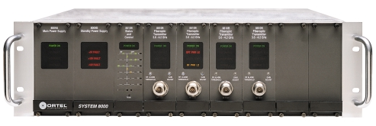
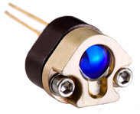
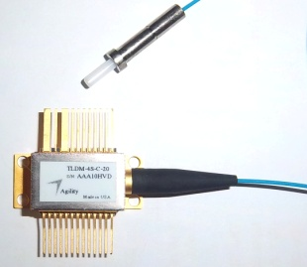
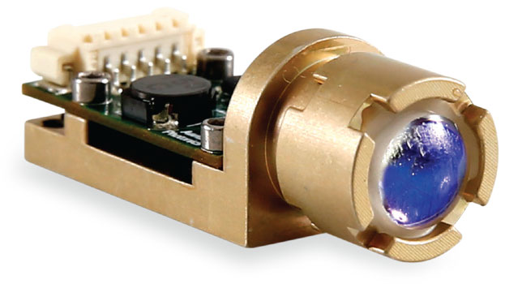
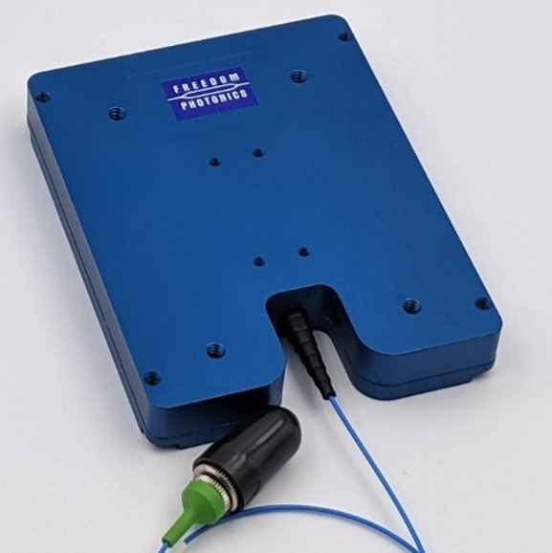
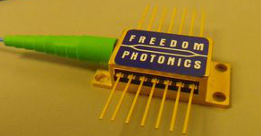
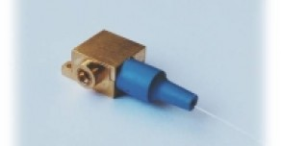
My Life at the Startups (1991 – Now)
Ortel
RF over Fiber
CATV Fiber Optic Systems
Agility
Monolithic widely tunable lasers
WDM Networks; Sensors
Aerius
Infrared Imaging Sensors
High Power Lasers
Miniature Laser Rangefinders
Freedom Photonics
High Power Lasers
Photonic Integration
Quantum sensing
High Power Photodiodes
Atacama
Successful business paths for startups

Slide 26
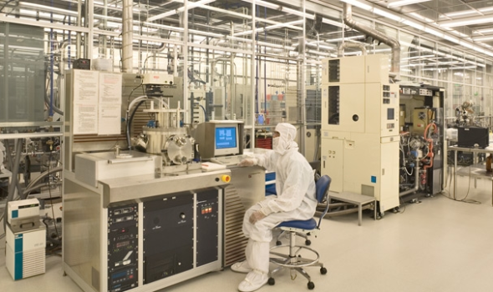
My Life at the Startups (1991 – Now)
High concentration of photonic startups around Santa Barbara, CA
“Infrared Corridor” along Highway 101
This is because:
University of California – Santa Barbara (UCSB) has a strong presence in the photonics world
New ideas from which to spawn a new startup
Strong interest in transferring IP from the university to businesses, in particular startup formation – startup culture
Generation of trained personnel to be hired by startups
Nanofabrication Facility (initially funded by NSF; managed by UCSB) provides startups with local access to a top-grade wafer fabrication facility
Several tens of millions of dollars in available equipment
Main facility can be accessed at $142/ hour

Slide 27
My Life at the Startups (1981 – Now)
Funding a Startup:
Ortel was bootstrap funded in the initial years
This means that you only rely on your sales (programs and products) and/or your own resources
US Government Small Business Innovation Research (SBIR) program is key (DoD, DoE, NASA, NSF, etc.)
Ortel was bootstrap funded and received private investment after about six years (Never losing control!)
Groups of private investors
Corporations
Agility Communications was venture capital funded
Larger capital infusions than bootstrapping
Company control can become an issue
Aerius Photonics was bootstrap funded all the way to its acquisition by FLIR
Freedom Photonics was bootstrap funded all the way to its acquisition by Luminar
There are pros and cons in all funding approaches
What is best depends on what you want to accomplish

Slide 28
My Life at the Startups (1991 – Now)
The Small Business Innovation Research (SBIR) program
Government Agencies (Dept of Defense, Energy, Health, Agriculture, NASA, NSF, etc) have to spend a % of their R&D budget to support small businesses through the SBIR program
The mission is to stimulate technological innovation and meet Federal Government needs through small businesses
A small business is defined as having no more than 500 employees
The program is competitive, each Government Agency has their own selection process
If small business is selected, the program has three phases:
Phase I: Establish the technical merit, feasibility and commercial potential – Understand risks of proposed effort Typically $50K - $250K for 6 – 9 months
Phase II: Conduct R&D effort, generally leading to a prototype demonstration
Typically $750K to $1.5M for 2 years
Phase III: Complete product development and pursue commercialization
Funding is variable and depends on project specifics
Many successes
Products that have their roots in the SBIR program:
- Roomba, developed by iRobot
- Lasik eye surgery, developed by IntraLase
- Cellular network equipment, by Qualcomm

Slide 29
Lessons
Lesson # 8: You cannot develop a photonic product entirely by yourself.
* You need more than just an internal team
* You also need an external ecosystem to support the startup company
Accessible
Wafer Fab
Government
Funding
Startup
Company
Private
Funding
Available
Trained
Personnel
Universities /
Research Labs

Slide 30
Lessons
Lesson # 8: You cannot develop a photonic product entirely by yourself.
* You need more than just an internal team
* You also need an external ecosystem to support the startup company
Photonic Startup
Ecosystem
Business &
Technical Support:
Accelerators,
Mentors, IT,
Consultants, etc.
Accessible
Wafer Fab
Government
Funding
Other Startups /
Other
Photonic Businesses
Startup
Company
Private
Funding
Sales
Channels
Regulations favoring job mobility
Outsource
Fab Facilities
Available
Trained
Personnel
Universities /
Research Labs

Slide 31
Lessons
Lesson # 9: You need a Plan that covers both Business and Technical aspects
Startup Plan / Proposal – The starting Business Plan
Utilize guidance from DARPA Heilmeier questions in formulating the plan
Effective planning consists of balancing five elements: Objectives (Payoff) / Approach / Resources / Schedule / Risks
1) Objectives:
What are you trying to do? Articulate your objectives using no jargon, so that an intelligent non-technical person can understand. Describe product specifications and financial related objectives.
What is the problem or opportunity? From a technical and a commercial perspective
Who are the customers? Why do they care?
If you are successful, what difference does it make? What impact will success have? How will it be measured? Technical and commercial success
2) Approach:
How is it done today, and what are the limits of current practice?
What’s new in your approach and why is it better than other approaches likely to be offered by the competition? Why do you think that you will be successful?

Slide 32
Lessons
Lesson # 9: You need a Plan that covers both Business and Technical aspects
Startup Plan / Proposal – The starting plan (continued)
3) Resources:
How much will it cost?
Manufacturing is key to the business – Photonics is a hardware business
Whoever manufactures controls Cost and thus, Profit
Sales is where the tire meets the road – Can we sell this stuff?
Whoever sells controls Price and thus, Profit
Manufacturing and Sales are the core of the photonic business – Make sure that you have appropriate resources
Engineering and Marketing support Manufacturing and Sales
Further support from HR, Facilities, IT, Finance, etc.
No need to control all Manufacturing and Sales – Appropriate outsourcing is OK
4) Schedule:
How long will it take?
What are interim milestones to check for progress towards success? How will progress be measured?
5) Risks:
What is the balance of risks and opportunities?
It is OK to have some areas in the plan that are undefined, with a stated effort to further define them
The plan has to take into account the fact that no one can predict the future – The plan has unknowns and balances risks

Slide 33
Lessons
Lesson # 10: Dare to act! What are you going to lose? What are you going to gain?
What is for you to do?
Follow your passion for novel ideas that solve problems
Articulate the ideas in the form of a Business Plan (including the five elements)
Work hard in all the details:
Connect with potential funders and customers
Manage all aspects of the company and product development program
Form a team, develop the company culture, set milestones, early prototype testing, etc
Working in a startup is a good opportunity to learn about finance, budgeting, sales, proposal preparation, psychology and… plumbing… among many other skills
Have fun! You will not regret to have followed a photonics startup life!
Virtuous spiral
What you do reinforces the ecosystem
You are part of a dynamic and fascinating community

Slide 34
Thank you!
Contact information:
Daniel Renner
daniel@atacamalight.com
+1-805-729-0514

